Slide 1
Vocabulary Week Two
Definitions and practice

Slide 2
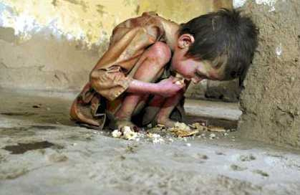
ABJECT
miserable
hopeless
http://ezeedictionary.com/forum/showthread.php/10-Image-Mnemonic-For-The-Word-ABJECT
The survivors of the typhoon were forced to live in abject conditions until help could arrive.

Slide 3
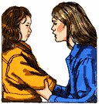
admonish
scold
warn
http://www.thefreedictionary.com/admonish
Why must I constantly admonish you about speeding?

Slide 4

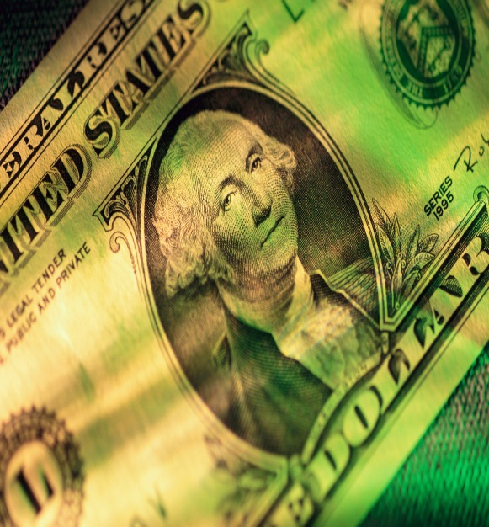
commensurate
equal in proportion
Four quarters are commensurate to one dollar.

Slide 5
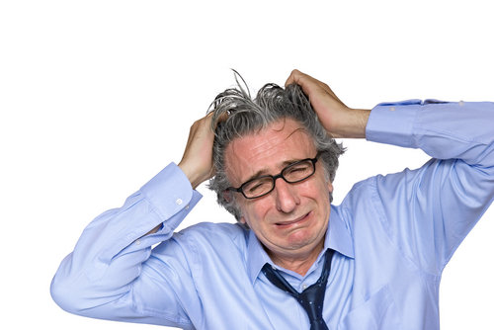
distraught
emotionally distressed
After losing his job, Jim was distraught.
http://daniela09.edublogs.org/files/2010/01/distraught.jpg

Slide 6
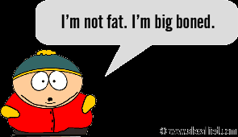
Euphemism
substituting mild language for language deemed too harsh

Slide 7
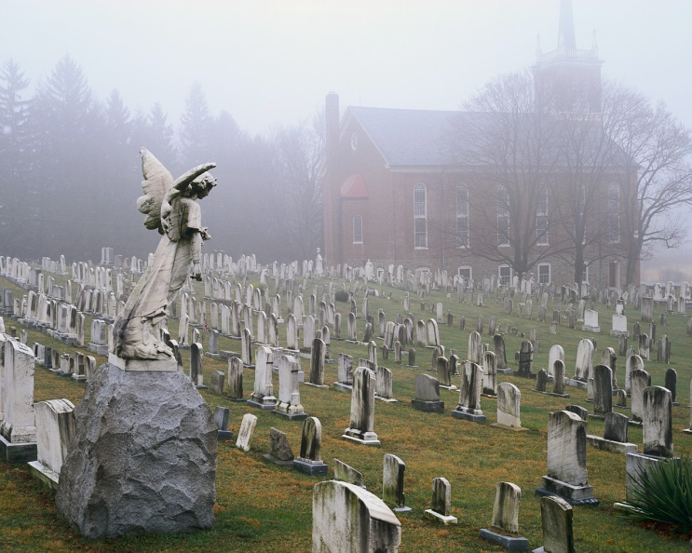
nebulous
ill-defined
in the form of a cloud or haze/hazy
The fog made the outlines of the church seem nebulous.

Slide 8

phlegmatic
indifferent
unemotional
apathetic
http://languagelog.ldc.upenn.edu/nll/?p=3806
It’s difficult to get Roy excited about politics; he’s completely phlegmatic about what happens in Washington.

Slide 9
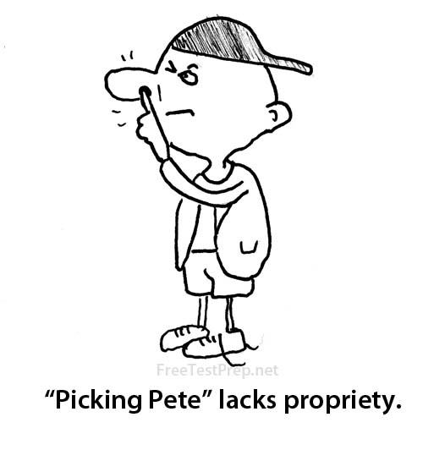
propriety
acceptable behavior
good manners
http://freetestprep.net/images/dictionary/propriety-pete.jpg

Slide 10
prosaic
commonplace
run-of-the-mill
unimaginative
dull, unexciting
Lately my life seems like nothing more than one prosaic task after another. I am in a rut of routineness.

Slide 11
Revile
insult
criticize in an abusive, angry manner
Tim’s boss would publically revile co-workers for making mistakes.

