Slide 1
Vocabulary Week One
Unit One

Slide 2
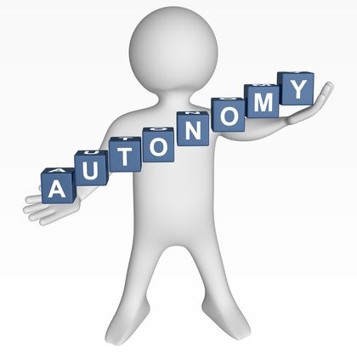
Autonomous (adjective)
self-governing
having the ability to self-govern
When you leave home, you will be autonomous.

Slide 3
Bacchanal (noun)
Drunken, riotous celebration
The New Year’s Eve bacchanal was one for the ages.

Slide 4
Benign (Adjective)
not malignant
kind and mild in nature

Slide 5
DEIGN (VERB)
To do something one feels is below his/her dignity
Lower oneself, condescend
Pete said he would not deign to listen to petty gossip.

Slide 6
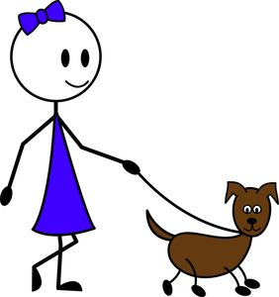
Erstwhile (adjective/adverb)
former/previous (adjective)
formerly/previously(adverb)
Dog-walking was Carla’s erstwhile job.

Slide 7
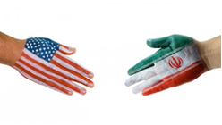
RAPPROCHMENT (NOUN)
Reconciliation (especially in international affairs)
Recently the U.S. and Iran have taken steps towards rapprochement.

Slide 8
SPECTRAL (ADJECTIVE)
ghostly
Hamlet is visited by the spectral image of his dead father.

Slide 9
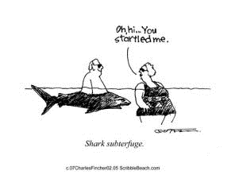
SUBTERFUGE (Noun)
deceitful trickery used to achieve a goal

Slide 10
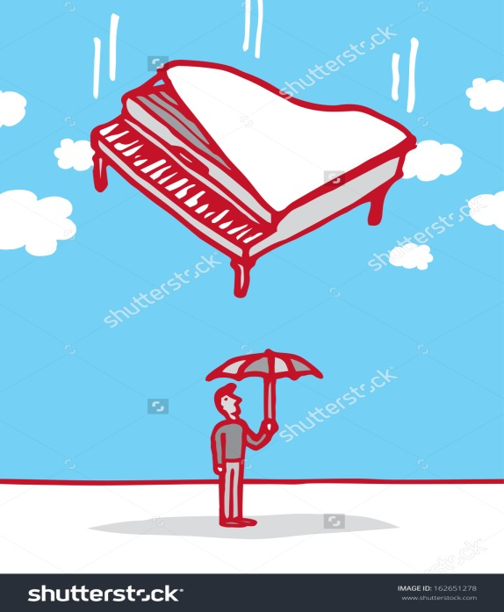
VICISSITUDE (NOUN)
a change in fortune (usually for the bad)
Andy thought he had prepared for any
vicissitude life might throw at him.

Slide 11
Vitriolic (ADJECTIVE)
corrosive, bitter, scathing, filled with malice

