Slide 1
Vocabulary
Week One Online Practice

Slide 2
BANAL
commonplace
so ordinary as to seem dull
I cannot bear another banal evening at the Richardson’s.

Slide 3
Bellicose
warlike
belligerent
aggressive
Carl’s bellicose attitude is disturbing; he is always trying to pick a fight.

Slide 4
Finesse
subtle manipulation
delicacy of workmanship
Cameron was able to finesse his boss into giving him the weekend off with pay.
I enjoy watching a skilled pool player finesse a difficult shot.

Slide 5
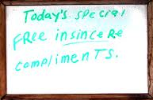
Glib
smooth but insincere
shallow
Though she said she was sorry, something about Mary’s apology seemed glib.
http://www.birdwatchersgeneralstore.com/Jokes.htm

Slide 6
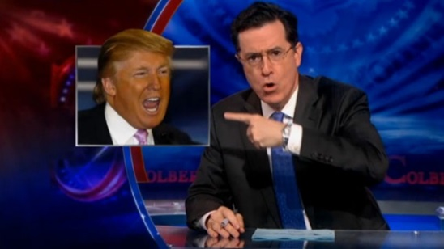
lampoon
satirize
mock or ridicule publically
Stephan Colbert loves to lampoon Donald Trump.
http://www.hollywoodreporter.com/live-feed/stephen-colbert-donald-trump-gop-debate-271002

Slide 7
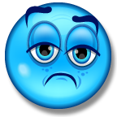
lugubrious
sad
sorrowful
The crash of the stock market left many investors feeling quite
lugubrious.

Slide 8
nefarious
wicked
evil
The nefarious witch chased Dorothy and Toto
through the land of Oz.

Slide 9
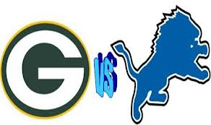
nemesis
archrival
adversary
opponent
The Green Bay Packers’ chief nemesis is the Detroit Lions.
http://nfl-live-streaming.com/nfl-detroit-lions-vs-green-bay-packers-live/#.UoL_Fdwo61s

Slide 10
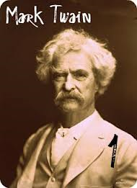
pseudonym
alias
fictitious name
Mark Twain was the pseudonym of the writer Samuel
Clemens.
http://fruitrootlife.wordpress.com/2011/08/17/great-pen-name-moments-successful-pseudonyms-part-2/

Slide 11
Purloin
steal
After cracking the safe’s combination, the thief was able to purloin thousands of dollars.

