Slide 1
Vocabulary
Unit Four: Week Eight Online Practice

Slide 2
Affable (adjective)
pleasant/friendly
Olaf is an affable snowman.

Slide 3
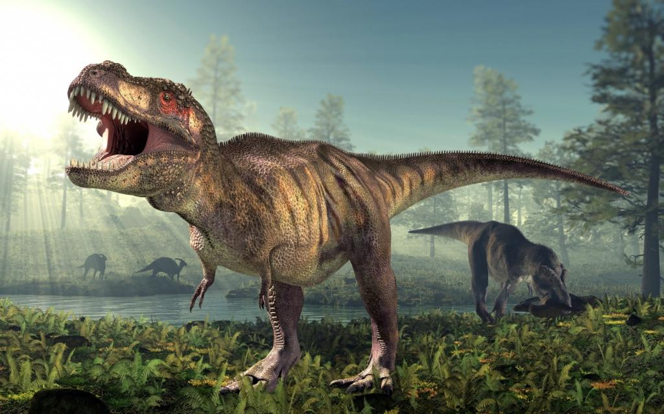
behemoth (NOUN)
something enormous in size and power
The T-rex was a behemoth.

Slide 4
evasive (adjective)
elusive/slippery in word and/or deed
Politicians often give evasive answers to questions.

Slide 5
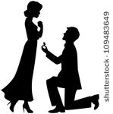
Genuflect (verb)
kneel
Many men genuflect when proposing to a woman.
http://www.hollywoodreporter.comive-feed/stephen-colbert-donald-trump-gop-debate-271002

Slide 6
Harangue (verb)
berate/lecture
The boss decided to harangue us for an hour.

Slide 7
Intrinsic (adjective)
inherent/built-in to personality or policy
People who have intrinsic motivation tend to be more successful in life.

Slide 8
ineffable (adjective)
indescribable
The sunrise was a thing of ineffable beauty.

Slide 9
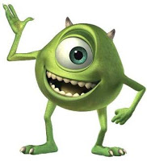
jocular (adjective)
humorous
Sully is a jocular fellow.

Slide 10
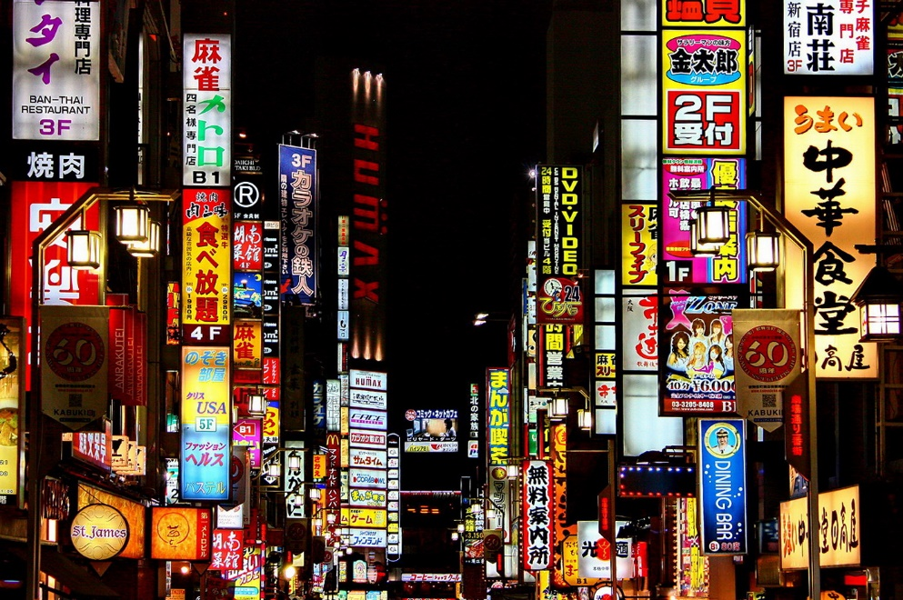
Venue (Noun)
location
Tokyo will be the venue of the 2020 Olympics.

Slide 11
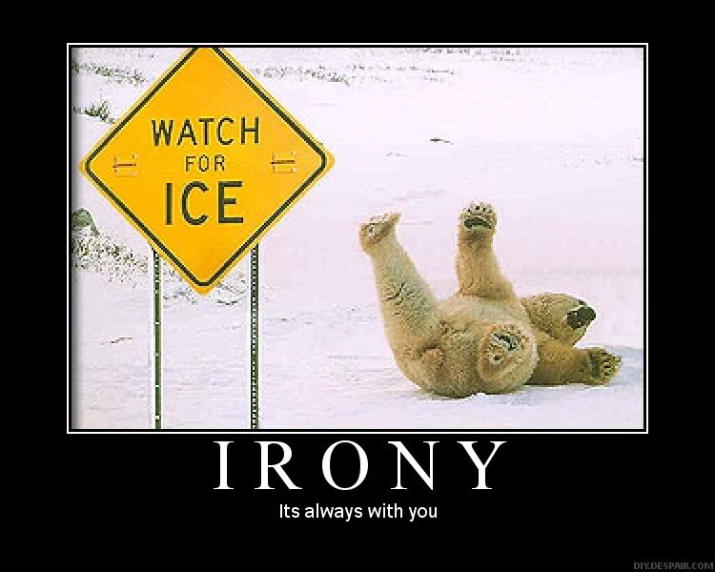
Wry (adjective)
ironic
I have a wry sense of humor.

