Slide 1
Vocabulary
Unit Four: Week Seven Online Practice

Slide 2
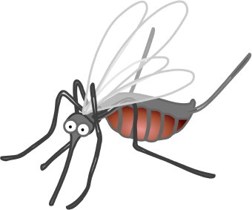
Bane (noun)
a nuisance
Mosquitoes are the bane of summer.

Slide 3
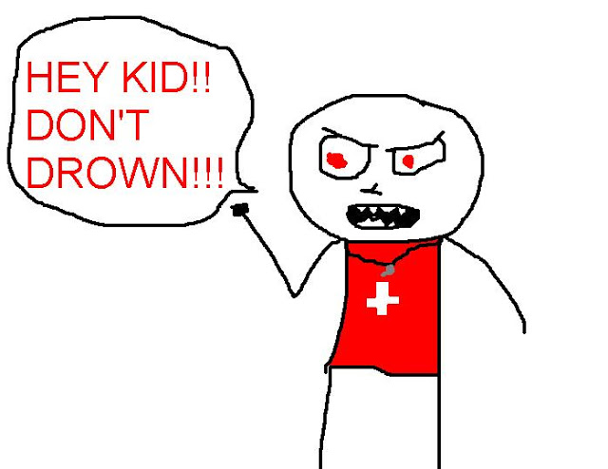
banish (verb)
expel/exile/force to leave
The lifeguard told the kids he would banish them from the pool if they continued to horseplay.

Slide 4
Chagrin (noun)
embarrassment
To Tim’s chagrin, he split his pants during gym class.

Slide 5
cravat (noun)
necktie
A silk cravat is a traditional Father’s Day gift.
http://www.hollywoodreporter.comive-feed/stephen-colbert-donald-trump-gop-debate-271002

Slide 6
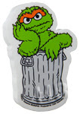
curmudgeon (Noun)
killjoy/ill-tempered person
Oscar the Grouch is a curmudgeon.

Slide 7
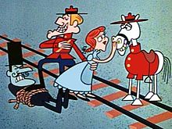
Fettered (verb)
bound/tied-up
The villain fettered his victim to the railroad track.

Slide 8
Gist (noun)
general idea
The gist of the story is that unicorns make rainbows.

Slide 9
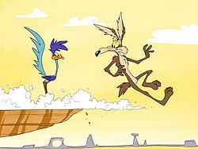
hapless (adjective)
luckless
The hapless coyote never catches the roadrunner.

Slide 10
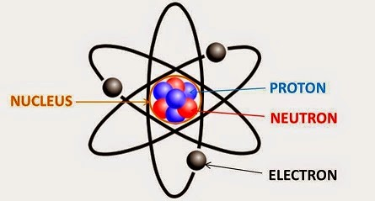
infinitesimal (adjective)
tiny
Atoms are infinitesimal bits of matter.

Slide 11
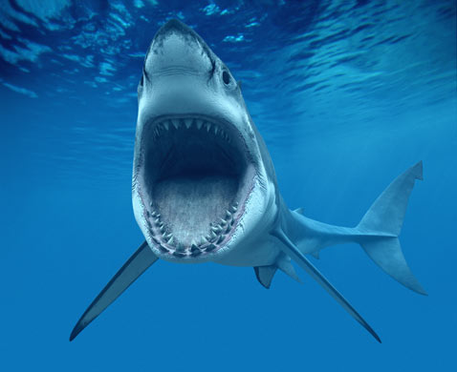
voracious (adjective)
insatiable
A great white shark has a voracious appetite.

