Slide 1
Vocabulary
Unit Four: Week Six Online Practice

Slide 2
Benison (noun)
a blessing
The priest gave the newlyweds
a benison.

Slide 3
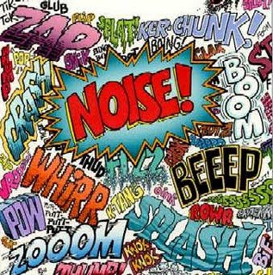
cacophony (noun)
jarring/discordant sounds
Between classes, there is a
cacophony in the hallway.

Slide 4
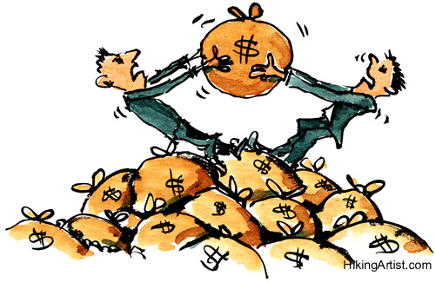
Cavil (verb)
quibble/nit-pick
You agreed to buy my car; let’s not cavil over the price.

Slide 5
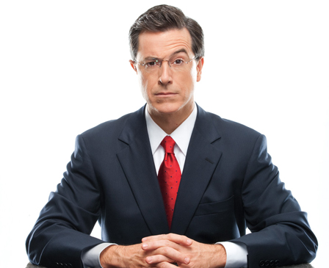
Derisive (adjective)
mocking
Stephan Colbert loves to make derisive comments about politicians.

Slide 6
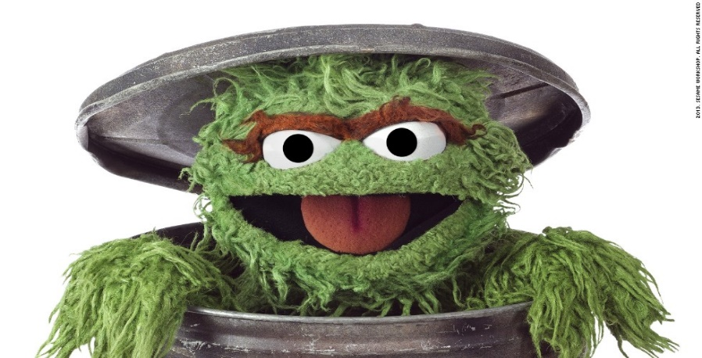
irascible (adjective)
irritable
Oscar the Grouch is irascible.
http://www.hollywoodreporter.comive-feed/stephen-colbert-donald-trump-gop-debate-271002

Slide 7
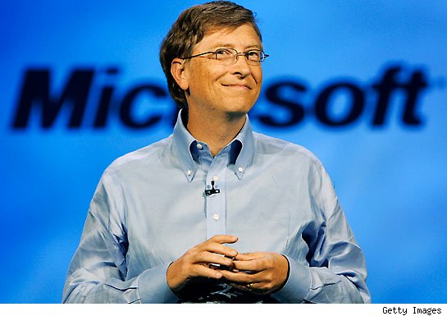
largesse (noun)
generosity
Bill Gates is known for his largesse.

Slide 8
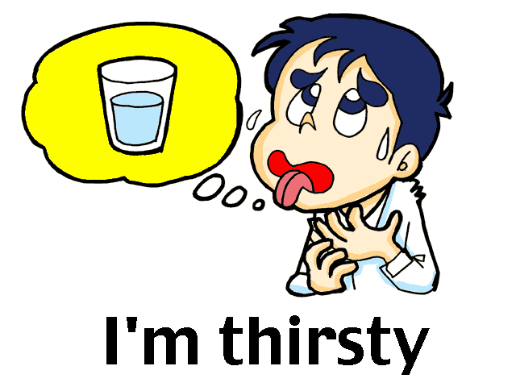
parched (adjective)
dry
After a workout, my mouth is parched.

Slide 9
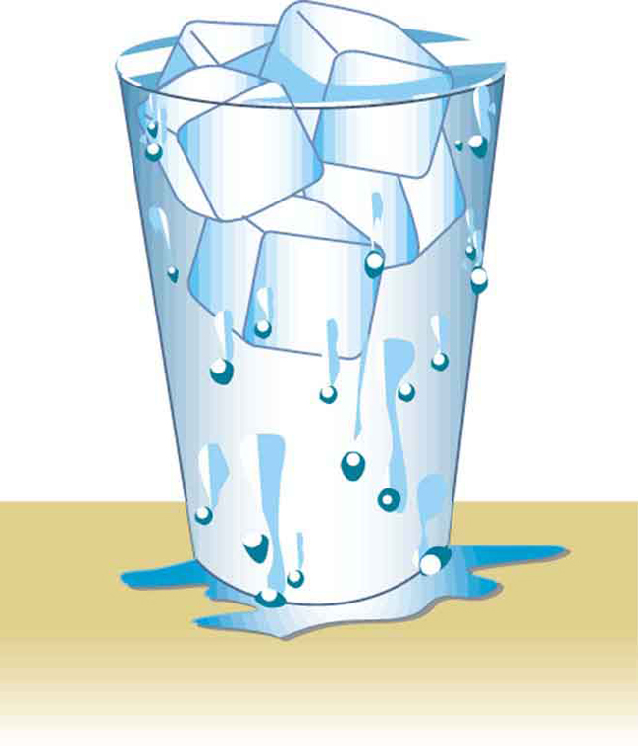
slake (verb)
satisfy
The only way to slake my thirst is with a large glass of water.

Slide 10
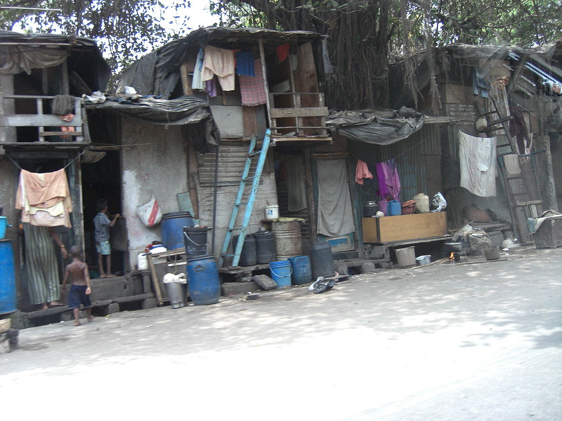
Squalid (adjective)
filthy
Unfortunately, many people around the world live in squalid conditions through no fault of their own.

Slide 11
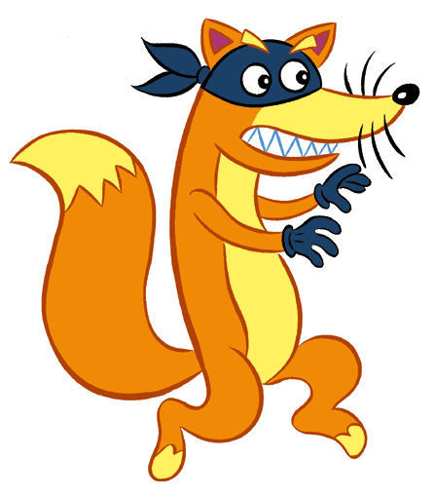
stealthy (adjective)
furtive/sneaky
The stealthy fox raided the hen house last night.

