Slide 1
Vocabulary
Unit Four: Week Five Online Practice

Slide 2
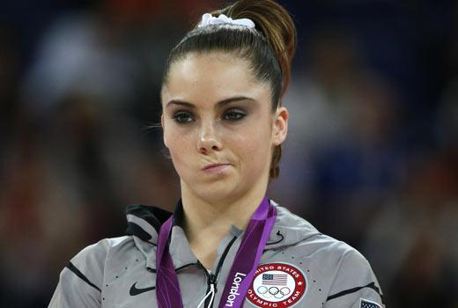
Blasé (adjective)
unconcerned
unimpressed because you’ve seen it before
Sherri was blasé about the ability of her competition.

Slide 3
contempt (noun)
disdain/hatred
Simon often shows contempt for the singing abilities of some contestants.

Slide 4
Devout (adjective)
religious faithfulness
My cousin, a devout Catholic, became a monk.

Slide 5
infidelity (noun)
unfaithful
Those who commit infidelity will usually find themselves out of a relationship.

Slide 6
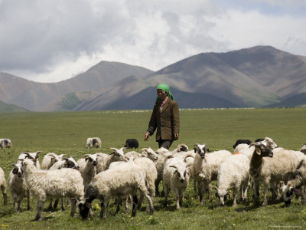
peripatetic (adjective)
nomadic/moving around often
Many sheepherders live a peripatetic lifestyle.
http://www.hollywoodreporter.comive-feed/stephen-colbert-donald-trump-gop-debate-271002

Slide 7
perspicacious (noun)
wise/insightful
My Nana was the most perspicacious person I ever knew.

Slide 8
Quixotic (adjective)
idealistic but impractical
Believing everyone will tell you the truth is a quixotic idea.

Slide 9
Renounce (verb)
give-up a habit or position
The mayor said she will renounce her support of higher taxes.

Slide 10
Skullduggery (noun)
dishonest behavior
Once you get a reputation for skullduggery, people will no longer trust you.

Slide 11
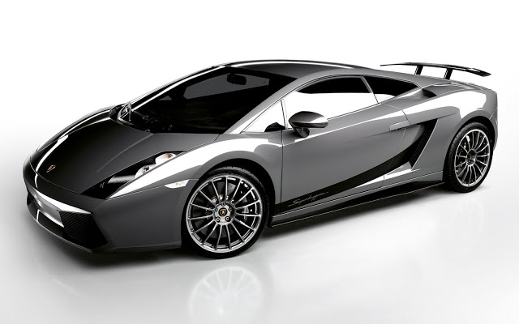
sully (verb)
tarnish/smear
Oh, no! The rain will sully my ride.

