Slide 1
Vocabulary
Unit Four: Week Four Online Practice

Slide 2
amenable (adjective)
agreeable
My boss was amenable to letting me leave early.

Slide 3
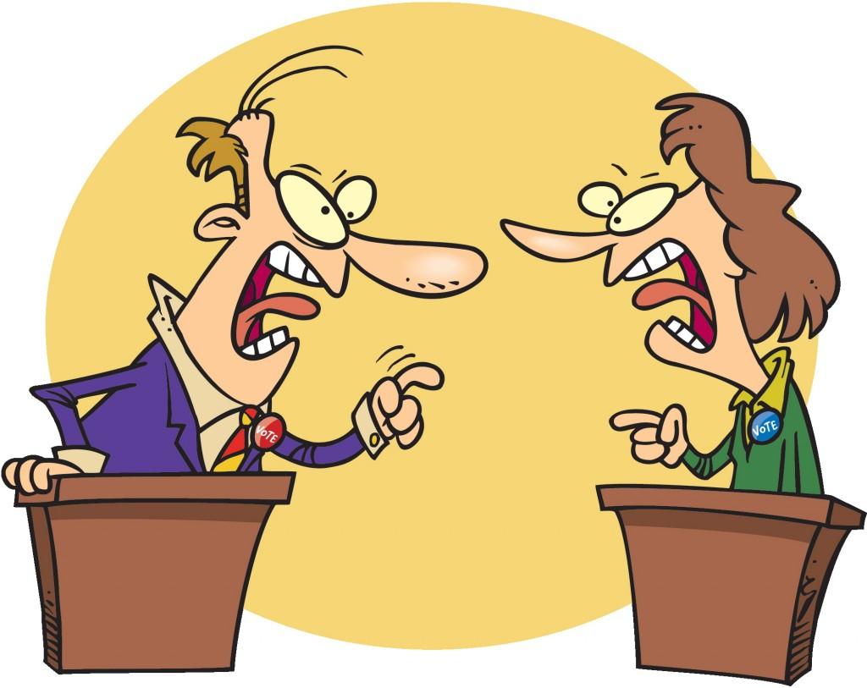
contentious (adjective)
controversial
Last night’s debate was filled with many contentious issues.

Slide 4
impinge (verb)
intrude
I don’t like it when people impinge on my privacy.

Slide 5
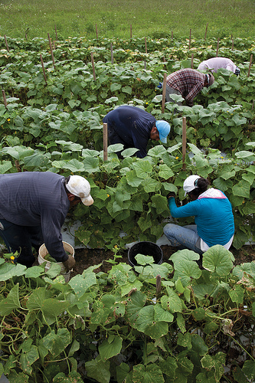
itinerant (adjective)
wandering/migrating
Much of the produce in this country is picked
by itinerant workers.

Slide 6
jaded (adjective)
world-weary/cynical
Politics can leave a person feeling jaded.
http://www.hollywoodreporter.comive-feed/stephen-colbert-donald-trump-gop-debate-271002

Slide 7
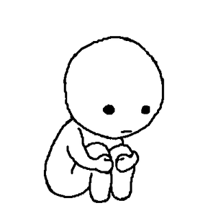
nihilism (noun)
a belief that life has no meaning
Depression can leave a person with a sense of nihilism.

Slide 8
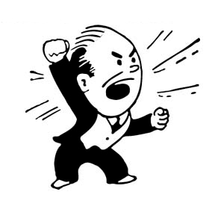
polemic (noun)
argumentative attack
The boss launched into a polemic
after he saw the quarterly sales figures.

Slide 9
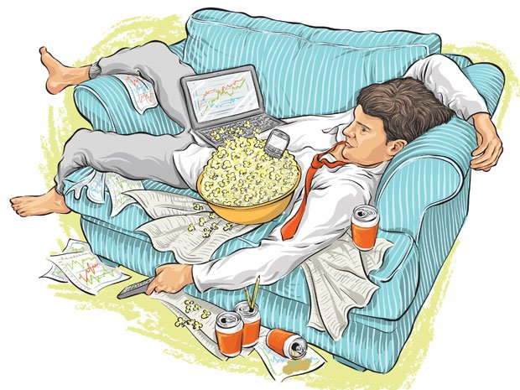
quotidian (adjective)
commonplace
Working until he falls asleep on the couch has become a
quotidian aspect of Jeff’s life.

Slide 10
untenable (adjective)
indefensible
Swearing in front of children is untenable.

Slide 11
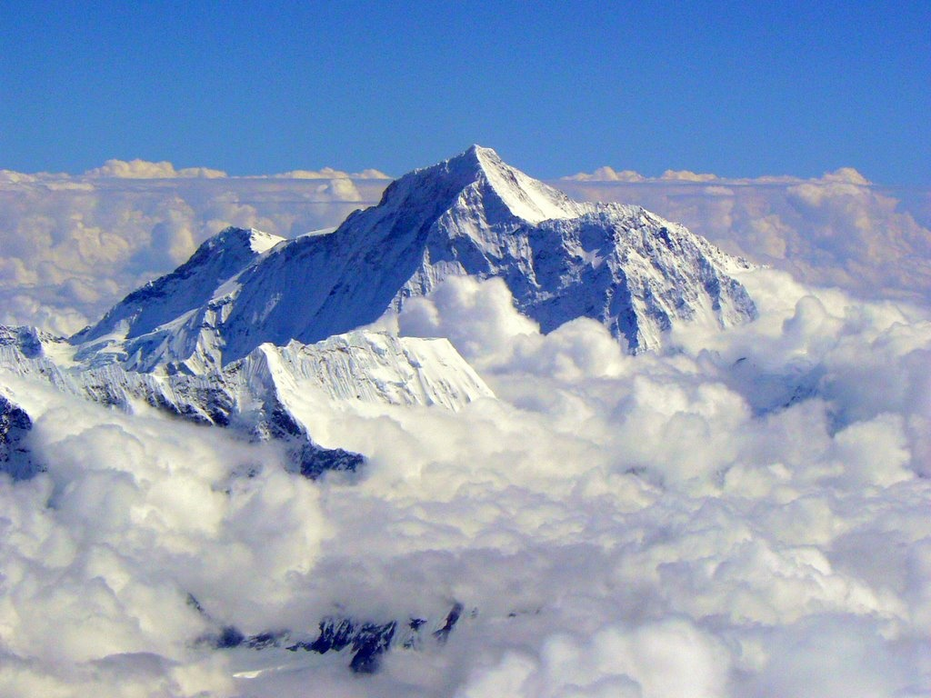
Zenith (noun)
peak/summit
The zenith of Mt. Everest is almost five miles above sea level.

