Slide 1
Vocabulary
Unit Four: Week Three Online Practice

Slide 2
affliction (noun)
illness/affliction
An affliction of the heart is
terrible thing.

Slide 3
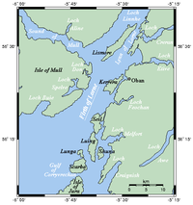
firth (noun)
a narrow arm of the sea
We sailed for hours along the firth.

Slide 4
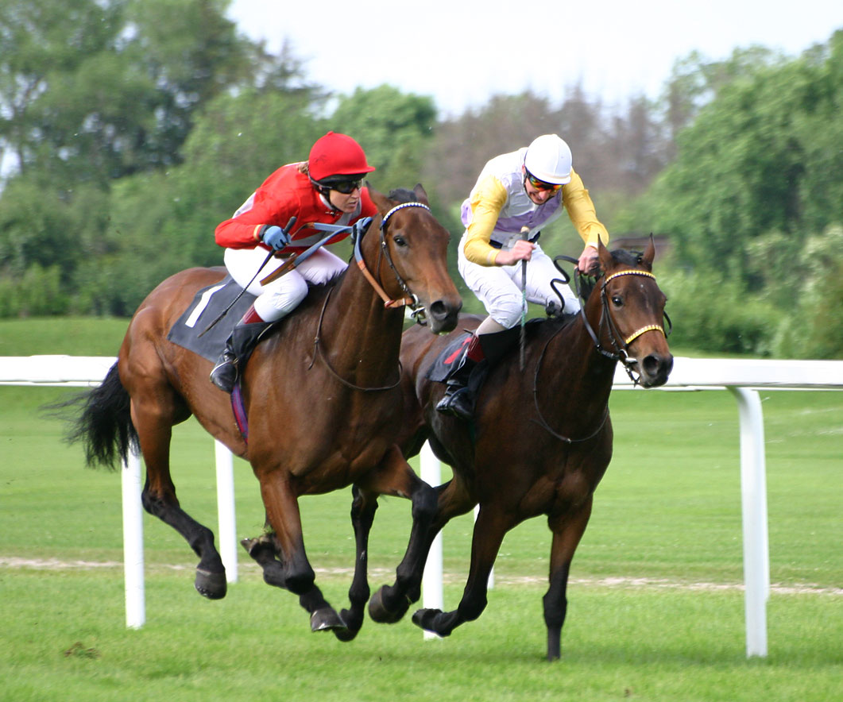
Furlong (noun)
1/8th of a mile
The racetrack is nine
furlongs.

Slide 5
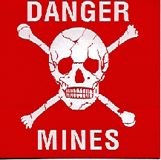
grievous (adjective)
serious/dreadful
A landmine can do grievous harm to soldiers.

Slide 6
Promontory (noun)
headland/elevated land overlooking water
The lighthouse sat atop the promontory.
http://www.hollywoodreporter.comive-feed/stephen-colbert-donald-trump-gop-debate-271002

Slide 7
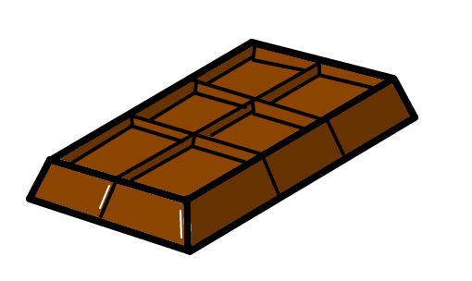
rapture (noun)
ecstasy/delight
I feel a sense of rapture when I eat chocolate.

Slide 8
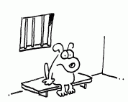
redress (verb)
rectify/put right
Sometimes community service is a way to redress a crime and avoid jail.

Slide 9
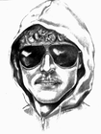
screed (noun)
long, tiresome piece of writing
The Unabomber was caught after his screed was published in the New York Times.

Slide 10
solace (noun)
comfort/consolation after loss
The American Red Cross provided solace to the storm’s victims.

Slide 11
winsome (adjective)
charming
Brad Pitt has a winsome smile.

