Slide 1
Vocabulary
Unit Four: Week Two Online Practice

Slide 2
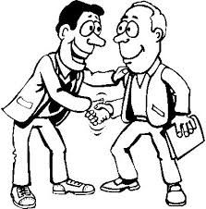
cordial (adjective)
pleasant/friendly
The meeting between the two men was
cordial.

Slide 3
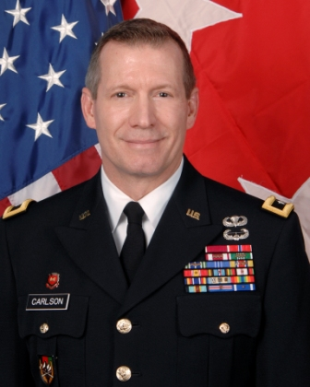
echelon (noun)
level/rank
Attaining the rank of general, put Jim into the upper echelon of the military.

Slide 4
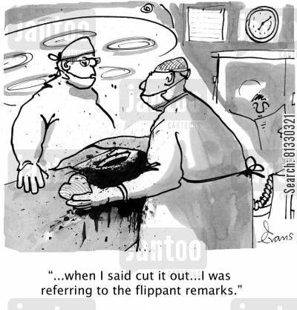
Flippant (adjective)
not serious/glib
making jokes about serious issues

Slide 5
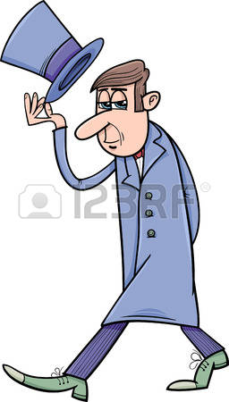
genteel (adjective)
refined/polite
Murray was well-liked for his genteel manners.

Slide 6
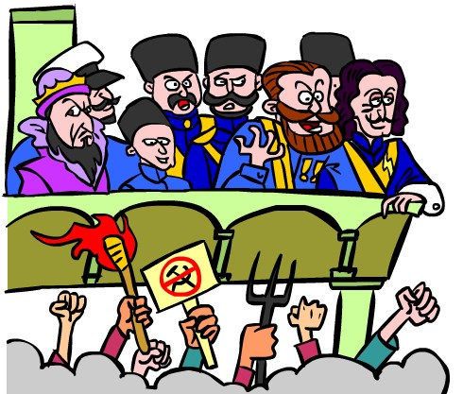
incite (verb)
provoke/inflame
The politician used his speech to incite the angry mob.
http://www.hollywoodreporter.comive-feed/stephen-colbert-donald-trump-gop-debate-271002

Slide 7
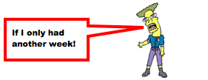
lament (verb)
mourn/grieve
Phil was forced to lament his procrastination.

Slide 8
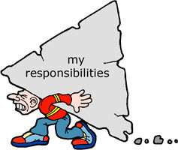
onus (noun)
burden/obligation
The onus of your future is on you.

Slide 9
orator (noun)
public speaker
Milton was a gifted orator.

Slide 10
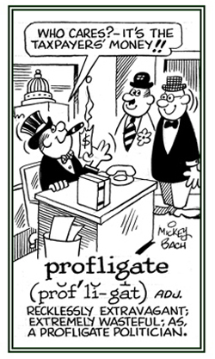
profligate (adjective)
wasteful/immoral
Politicians are often accused of being profligate.

Slide 11
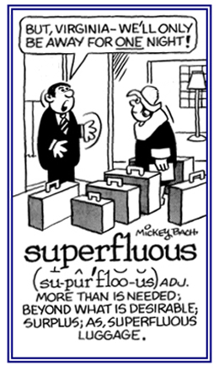
Superfluous (adjective)
extra/beyond what is needed

