Slide 1
Vocabulary
Unit Four: Week One Online Practice

Slide 2
Archaeology (noun)
systematic study of ancient human life
Indiana Jones was a teacher of archaeology.

Slide 3
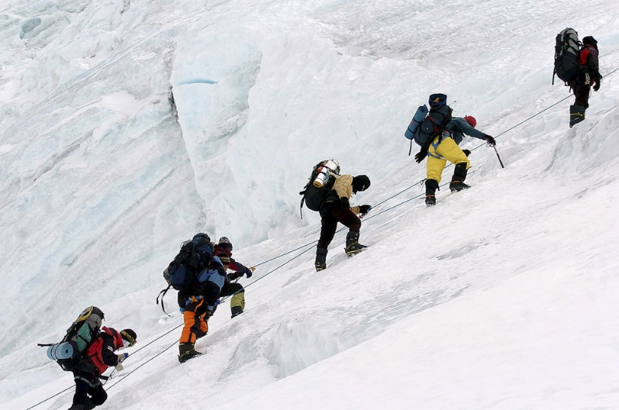
Fruition (noun)
culmination/completion
Our plan to climb Mount Everest finally came to fruition after many years of planning.

Slide 4
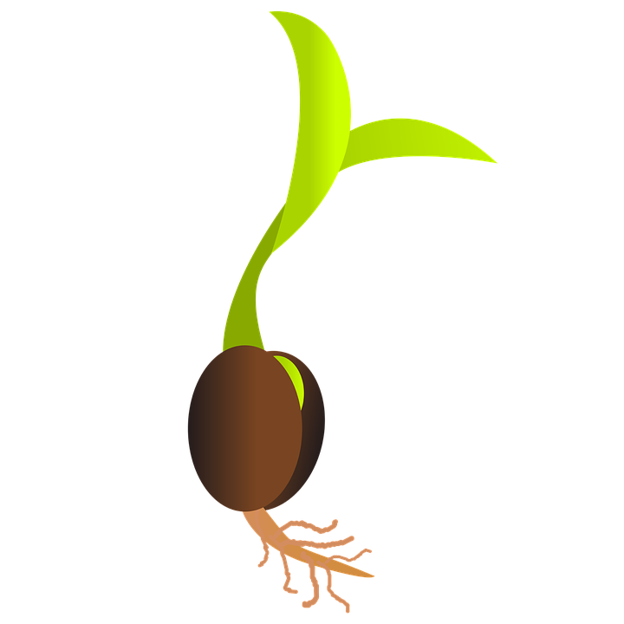
Germinate (verb)
sprout
It took a week for the plant to germinate.

Slide 5
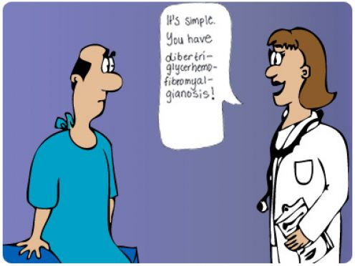
Jargon (noun)
terminology
Every profession has its own
type of jargon.
EvE

Slide 6
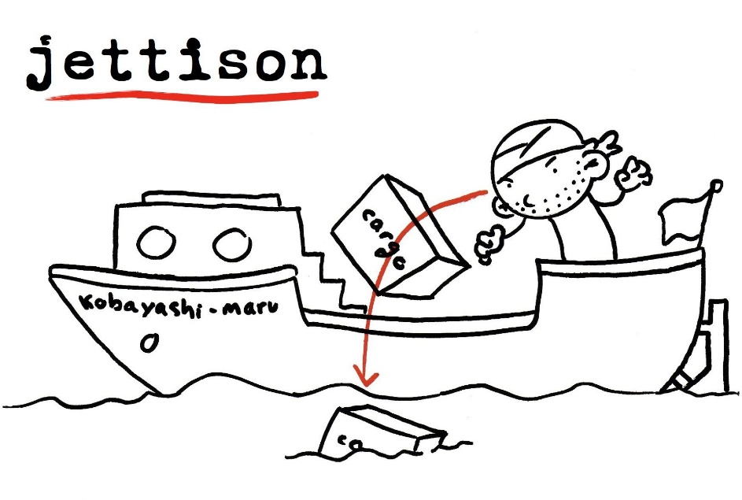
Jettison (verb)
throw overboard
As the ship was sinking, the
crew had to jettison the
cargo.
http://www.hollywoodreporter.com/live-feed/stephen-colbert-donald-trump-gop-debate-271002

Slide 7
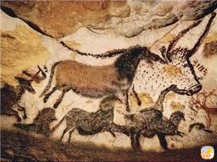
Paleolithic (adjective)
related to the Stone Age
The Paleolithic cave-paintings in Lascaux are amazing.

Slide 8
Perspective (noun)
viewpoint
We all have our own
perspective on life.

Slide 9
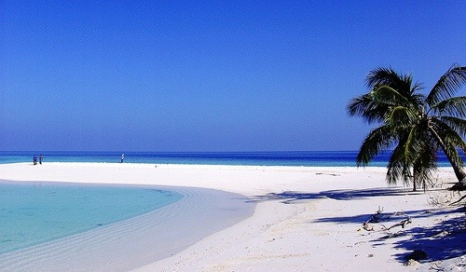
Pristine (adjective)
primitive/untouched
We spent our break on a
pristine beach.

Slide 10
Scavenge (Verb)
hunt or forage
Vultures scavenge for road-kill.

Slide 11
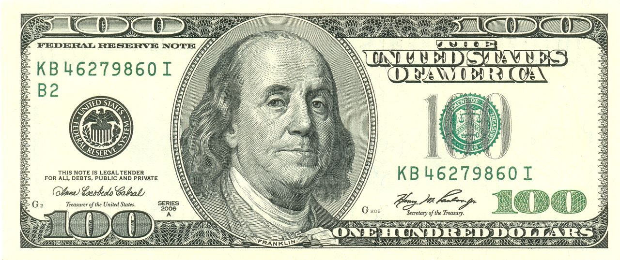
Serendipity (noun)
luck/random chance
It was pure serendipity that I found a 100 dollar bill.

