Slide 1
1984
by
George Orwell

Slide 2
Focus Questions
Who was George Orwell?
Which country did he have in mind when he wrote 1984?
How has the word Orwellian worked its way into the English language?
What do the terms paradox, doublespeak, doublethink, facecrime, thoughtcrime, and Thought Police mean?

Slide 3
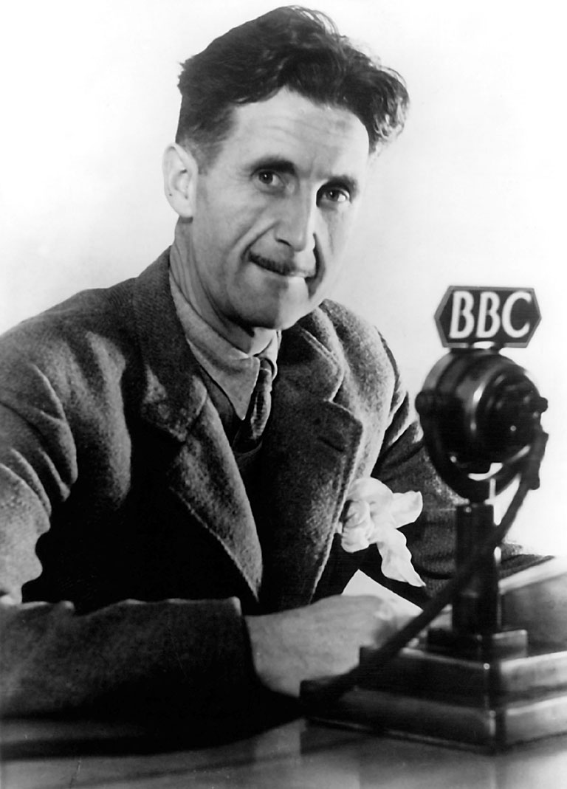
Eric Blair
Born in India (British Colony)
Worked as a teacher, policeman, journalist
Strongly opposed to totalitarianism
Believed that government control of language and information would lead to totalitarianism
Wrote under the pseudonym: George Orwell

Slide 4
Who Did He Have in Mind?
1984 and Animal Farm were written after WWII
The totalitarian government of the USSR was thought to be the model for his writings.
Orwell is sometimes credited with coining the phrase: Cold War
Now his writings are used to refer to any government attempting to exert absolute control of its population through violence, fear, and propaganda.

Slide 5
Paradox
a seemingly absurd or self-contradictory statement or proposition that when investigated or explained may prove to be well founded or true

Slide 6
The Party Slogans
WAR IS PEACE
IGNORANCE IS STRENGTH
FREEDOM IS SLAVERY

Slide 7
Orwellian Jargon
doublespeak
not actually used in the novel, but has come to mean language that is deliberately misleading or euphemistic e.g.:
downsizing

Slide 8
Orwellian Jargon
doublethink
the ability to hold two mutually contradictory ideas in one’s head

Slide 9
Orwellian Jargon
thoughtcrime
facecrime
Thought Police
thinking thoughts that violate the Party line
showing an emotion that indicates your disdain for the Party
the government agency tasked with arresting thought-criminals

Slide 10
The Ministries
The Ministry of Peace
The Ministry of Love
The Ministry of Truth
The Ministry of Plenty

